Slide 1
CSE 4109: Artificial Intelligence
Constraint Satisfaction Problems
M.M.A. Hashem, PhD
Professor,
Dept. of Computer Science and Engineering
Khulna University of Engineering & Technology (KUET)
Khulna 9203, Bangladesh
Email; hashem@cse.kuet.ac.bd
Cell Phone: +880 1714 003949

Slide 2
Constraint Satisfaction Problems
Russell and Norvig:
Parts of Chapter 5

Slide 3
Intro Example: 8-Queens
CSE 4109: Artificial Intelligence

Slide 4
Intro Example: 8-Queens
5 5 5 5 5 6 7
6
6
5
5
5
5
6
CSE 4109: Artificial Intelligence

Slide 5
Intro Example: 8-Queens
4 3 3 3 4 5
3
4
4
3
3
5
CSE 4109: Artificial Intelligence

Slide 6
Intro Example: 8-Queens
3 3 3 4 3
4
3
2
3
4
CSE 4109: Artificial Intelligence

Slide 7
Intro Example: 8-Queens
3 3 3 1
4
2
2
1
3
CSE 4109: Artificial Intelligence

Slide 8
Intro Example: 8-Queens
2 2 1
2
2
1
CSE 4109: Artificial Intelligence

Slide 9
Intro Example: 8-Queens
CSE 4109: Artificial Intelligence

Slide 10
Intro Example: 8-Queens
CSE 4109: Artificial Intelligence

Slide 11
What is Needed?
Not just a successor function and goal test
But also a means to propagate the constraints imposed by one queen on the others and an early failure test
→ Explicit representation of constraints and constraint manipulation algorithms
CSE 4109: Artificial Intelligence

Slide 12
Constraint Satisfaction Problem
Set of variables {X1, X2, …, Xn}
Each variable Xi has a domain Di of possible values. Usually, Di is discrete and finite
Set of constraints {C1, C2, …, Cp}
Each constraint Ck involves a subset of variables and specifies the allowable combinations of values of these variables
Assign a value to every variable such that all constraints are satisfied
CSE 4109: Artificial Intelligence

Slide 13
Example: 8-Queens Problem
64 variables Xij, i = 1 to 8, j = 1 to 8
Domain for each variable {1,0}
Constraints are of the forms:
  Xij = 1 ➔ Xik = 0 for all k = 1 to 8, k≠j
  Xij = 1 ➔ Xkj = 0 for all k = 1 to 8, k≠i
  Similar constraints for diagonals
  ΣXij = 8
CSE 4109: Artificial Intelligence

Slide 14
Example: 8-Queens Problem
8 variables Xi, i = 1 to 8
Domain for each variable {1,2,…,8}
Constraints are of the forms:
  Xi = k ➔ Xj ≠ k for all j = 1 to 8, j≠i
  Similar constraints for diagonals
CSE 4109: Artificial Intelligence

Slide 15
Example: Map Coloring
NT
NT
Q
Q
WA
WA
SA
SA
NSW
NSW
V
V
T
T
7 variables {WA,NT,SA,Q,NSW,V,T}
Each variable has the same domain {red, green, blue}
No two adjacent variables have the same value:
WA≠NT, WA≠SA, NT≠SA, NT≠Q, SA≠Q, SA≠NSW, SA≠V,Q≠NSW, NSW≠V
CSE 4109: Artificial Intelligence

Slide 16
Example: Street Puzzle
1
2
3
4
5
Ni = {English, Spaniard, Japanese, Italian, Norwegian}
Ci = {Red, Green, White, Yellow, Blue}
Di = {Tea, Coffee, Milk, Fruit-juice, Water}
Ji = {Painter, Sculptor, Diplomat, Violonist, Doctor}
Ai = {Dog, Snails, Fox, Horse, Zebra}
The Englishman lives in the Red house
The Spaniard has a Dog
The Japanese is a Painter
The Italian drinks Tea
The Norwegian lives in the first house on the left
The owner of the Green house drinks Coffee
The Green house is on the right of the White house
The Sculptor breeds Snails
The Diplomat lives in the Yellow house
The owner of the middle house drinks Milk
The Norwegian lives next door to the Blue house
The Violonist drinks Fruit juice
The Fox is in the house next to the Doctor’s
The Horse is next to the Diplomat’s
Who owns the Zebra?
Who drinks Water?
CSE 4109: Artificial Intelligence

Slide 17
Example: Street Puzzle
1
2
3
4
5
Ni = {English, Spaniard, Japanese, Italian, Norwegian}
Ci = {Red, Green, White, Yellow, Blue}
Di = {Tea, Coffee, Milk, Fruit-juice, Water}
Ji = {Painter, Sculptor, Diplomat, Violonist, Doctor}
Ai = {Dog, Snails, Fox, Horse, Zebra}
The Englishman lives in the Red house
The Spaniard has a Dog
The Japanese is a Painter
The Italian drinks Tea
The Norwegian lives in the first house on the left → N1 = Norwegian
The owner of the Green house drinks Coffee
The Green house is on the right of the White house
The Sculptor breeds Snails
The Diplomat lives in the Yellow house
The owner of the middle house drinks Milk → D3 = Milk
The Norwegian lives next door to the Blue house
The Violonist drinks Fruit juice
The Fox is in the house next to the Doctor’s
The Horse is next to the Diplomat’s
CSE 4109: Artificial Intelligence

Slide 18
Example: Street Puzzle
1
2
3
4
5
Ni = {English, Spaniard, Japanese, Italian, Norwegian}
Ci = {Red, Green, White, Yellow, Blue}
Di = {Tea, Coffee, Milk, Fruit-juice, Water}
Ji = {Painter, Sculptor, Diplomat, Violonist, Doctor}
Ai = {Dog, Snails, Fox, Horse, Zebra}
The Englishman lives in the Red house → C1 ≠ Red
The Spaniard has a Dog
The Japanese is a Painter
The Italian drinks Tea
The Norwegian lives in the first house on the left → N1 = Norwegian
The owner of the Green house drinks Coffee
The Green house is on the right of the White house
The Sculptor breeds Snails
The Diplomat lives in the Yellow house
The owner of the middle house drinks Milk → D3 = Milk
The Norwegian lives next door to the Blue house
The Violonist drinks Fruit juice
The Fox is in the house next to the Doctor’s
The Horse is next to the Diplomat’s
CSE 4109: Artificial Intelligence

Slide 19
Example: Street Puzzle
1
2
3
4
5
Ni = {English, Spaniard, Japanese, Italian, Norwegian}
Ci = {Red, Green, White, Yellow, Blue}
Di = {Tea, Coffee, Milk, Fruit-juice, Water}
Ji = {Painter, Sculptor, Diplomat, Violonist, Doctor}
Ai = {Dog, Snails, Fox, Horse, Zebra}
The Englishman lives in the Red house → C1 ≠ Red
The Spaniard has a Dog
The Japanese is a Painter
The Italian drinks Tea
The Norwegian lives in the first house on the left → N1 = Norwegian
The owner of the Green house drinks Coffee
The Green house is on the right of the White house
The Sculptor breeds Snails
The Diplomat lives in the Yellow house
The owner of the middle house drinks Milk → D3 = Milk
The Norwegian lives next door to the Blue house
The Violonist drinks Fruit juice → J3 ≠ Violonist
The Fox is in the house next to the Doctor’s
The Horse is next to the Diplomat’s
CSE 4109: Artificial Intelligence

Slide 20
Example: Task Scheduling
T1
T2
T4
T3
T1 must be done during T3
T2 must be achieved before T1 starts
T2 must overlap with T3
T4 must start after T1 is complete
Are the constraints compatible?
What are the possible time relations between two tasks?
CSE 4109: Artificial Intelligence

Slide 21
Finite vs. Infinite CSP
Finite domains of values → finite CSP
Infinite domains → infinite CSP
(particular case: linear programming)
CSE 4109: Artificial Intelligence

Slide 22
Finite vs. Infinite CSP
Finite domains of values → finite CSP
Infinite domains → infinite CSP
We will only consider finite CSP
CSE 4109: Artificial Intelligence

Slide 23
CSP as a Search Problem
Initial state: empty assignment
Successor function: a value is assigned to any unassigned variable, which does not conflict with the currently assigned variables
Goal test: the assignment is complete
Path cost: irrelevant
n variables of domain size d
→ O(d^{n}) distinct complete assignments
CSE 4109: Artificial Intelligence

Slide 24
Remark
Finite CSP include 3SAT as a special case
3SAT is known to be NP-complete
So, in the worst-case, we cannot expect to solve a finite CSP in less than exponential time
CSE 4109: Artificial Intelligence

Slide 25
Commutativity of CSP
The order in which values are assigned
to variables is irrelevant to the final
assignment, hence:
Generate successors of a node by
considering assignments for only one
variable
Do not store the path to node
CSE 4109: Artificial Intelligence

Slide 26
→ Backtracking Search
empty assignment
1st variable
2nd variable
3rd variable
Assignment = {}
CSE 4109: Artificial Intelligence

Slide 27
→ Backtracking Search
empty assignment
1st variable
2nd variable
3rd variable
Assignment = {(var1=v11)}
CSE 4109: Artificial Intelligence

Slide 28
→ Backtracking Search
empty assignment
1st variable
2nd variable
3rd variable
Assignment = {(var1=v11),(var2=v21)}
CSE 4109: Artificial Intelligence

Slide 29
→ Backtracking Search
empty assignment
1st variable
2nd variable
3rd variable
Assignment = {(var1=v11),(var2=v21),(var3=v31)}
CSE 4109: Artificial Intelligence

Slide 30
→ Backtracking Search
empty assignment
1st variable
2nd variable
3rd variable
Assignment = {(var1=v11),(var2=v21),(var3=v32)}
CSE 4109: Artificial Intelligence

Slide 31
→ Backtracking Search
empty assignment
1st variable
2nd variable
3rd variable
Assignment = {(var1=v11),(var2=v22)}
CSE 4109: Artificial Intelligence

Slide 32
→ Backtracking Search
empty assignment
1st variable
2nd variable
3rd variable
Assignment = {(var1=v11),(var2=v22),(var3=v31)}
CSE 4109: Artificial Intelligence

Slide 33
Backtracking Algorithm
assignment
of variables
CSP-BACKTRACKING({})
CSP-BACKTRACKING(a)
  If a is completed, then return a
  X ← select unassigned variable
  D ← select an ordering for the domain of X
  For each value v in D do
    If v is consistent with a then
      Add (X= v) to a
      result ← CSP-BACKTRACKING(a)
      If result ≠ failure then return result
  Return failure
CSE 4109: Artificial Intelligence

Slide 34
Map Coloring
{}
WA=red
WA=green
WA=blue
WA=red
NT=green
WA=red
NT=blue
NT
Q
WA
WA=red
NT=green
Q=red
WA=red
NT=green
Q=blue
SA
NSW
V
T
CSE 4109: Artificial Intelligence

Slide 35
Questions
Which variable X should be assigned a value next?
In which order should its domain D be sorted?
CSE 4109: Artificial Intelligence

Slide 36
Choice of Variable
Map coloring
NT
NT
Q
WA
WA
SA
SA
NSW
V
SA has one remaining value
Q has 2
The others have 3
T
CSE 4109: Artificial Intelligence

Slide 37
Choice of Variable
4
3
2
3
4
CSE 4109: Artificial Intelligence

Slide 38
Choice of Variable
4
2
2
1
3
CSE 4109: Artificial Intelligence

Slide 39
Choice of Variable
Most-constrained-variable heuristic:
Select a variable with the fewest remaining values
(Rationale: Reduce branching factor)
CSE 4109: Artificial Intelligence

Slide 40
Choice of Variable
NT
Q
WA
Most-constraining-variable heuristic:
Select the variable that is involved in the largest number of constraints on other unassigned variables
(Rationale: Maximize the number of values eliminated, hence future branching factors)
SA
SA
NSW
V
T
CSE 4109: Artificial Intelligence

Slide 41
Choice of Value
NT
NT
Q
WA
WA
SA
NSW
V
{}
T
CSE 4109: Artificial Intelligence

Slide 42
Choice of Value
NT
NT
Q
WA
WA
SA
NSW
V
{blue}
T
Least-constraining-value heuristic:
Prefer the value that leaves the largest subset of legal values for other unassigned variables
CSE 4109: Artificial Intelligence

Slide 43
Compare!!
Most-constraining-variable heuristic: Select the variable that is involved in the largest number of constraints on other unassigned variables. (Rationale: maximize the number of values eliminated, hence future branching factors)
Least-constraining-value heuristic: Prefer the value that leaves the largest subset of legal values for other unassigned variables
Each variable will eventually have a value assigned to it (so, pick first the most-constraining one)
but a value does not have to be assigned
(so, pick first the least-constraining one)
CSE 4109: Artificial Intelligence

Slide 44
Local Search for CSP
1
2
2
0
3
2
3
2
2
2
2
2
3
2
Pick initial complete assignment (at random)
Repeat
  Pick a conflicted variable var (at random)
  Set the new value of var to minimize the number of conflicts
  If the new assignment is not conflicting then return it
(min-conflicts heuristics)
CSE 4109: Artificial Intelligence

Slide 45
Why Does It Work?
Local search with min-conflict heuristic works extremely well for million-queen problems
The reason: Solutions are densely distributed in the O(n^{n}) space, which means that on the average a solution is only a few steps away from a randomly picked assignment
CSE 4109: Artificial Intelligence

Slide 46
Applications
CSP techniques have allowed solving very complex problems
Numerous applications, e.g.:
  Crew assignments to flights
  Management of transportation fleet
  Flight/rail schedules
  Task scheduling in port operations
  Design
  Brain surgery
CSE 4109: Artificial Intelligence

Slide 47
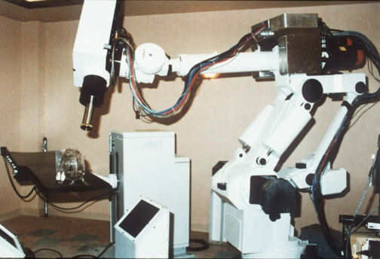
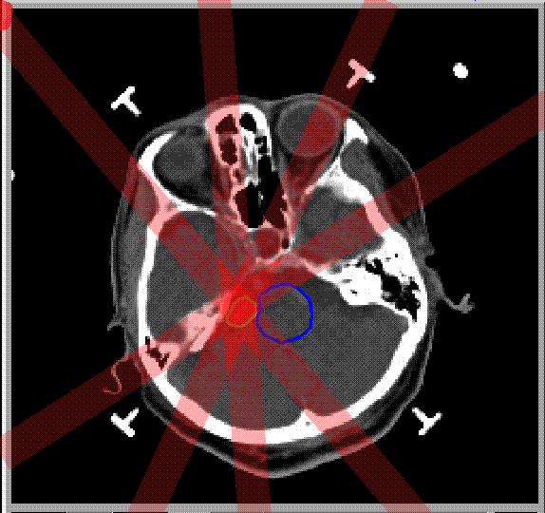
Stereotaxic Brain Surgery
CSE 4109: Artificial Intelligence

Slide 48
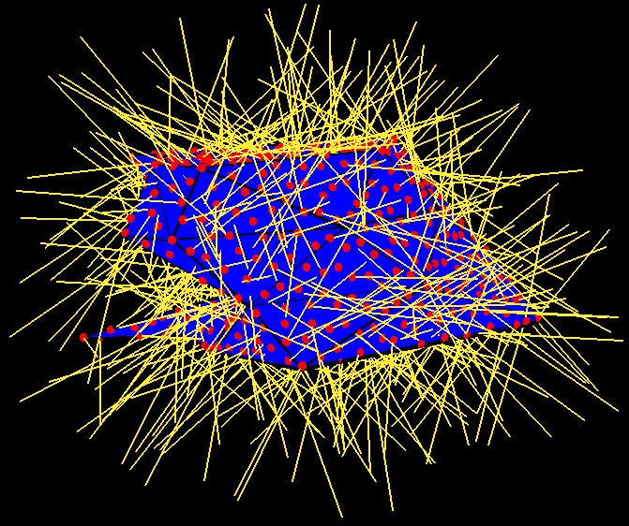
Stereotaxic Brain Surgery
• 2000 < Tumor < 2200
  2000 < B2 + B4 < 2200
  2000 < B4 < 2200
  2000 < B3 + B4 < 2200
  2000 < B3 < 2200
  2000 < B1 + B3 + B4 < 2200
  2000 < B1 + B4 < 2200
  2000 < B1 + B2 + B4 < 2200
  2000 < B1 < 2200
  2000 < B1 + B2 < 2200
T
B1
T
B2
C
B4
B3
• 0 < Critical < 500
  0 < B2 < 500
CSE 4109: Artificial Intelligence

Slide 49

Stereotaxic Brain Surgery
CSE 4109: Artificial Intelligence

Slide 50
→ Constraint Programming
“Constraint programming represents one of the closest approaches computer science has yet made to the Holy Grail of programming: the user states the problem, the computer solves it.”
Eugene C. Freuder, Constraints, April 1997
CSE 4109: Artificial Intelligence

Slide 51
Summary
Constraint Satisfaction Problems (CSP)
CSP as a search problem
Backtracking algorithm
General heuristics
Local search technique
Constraint programming
CSE 4109: Artificial Intelligence

